Slide 1
SAVING COMPONENTS, HUNTING BUGS, ANGULAR BUSINESS
Bünyamin Coşkuner
19.08.2017
GDG Istanbul August'17
Notes:
*

Slide 2


Slide 3
Agenda
What's AngularJs?
AngularJs vs Angular
Migration from AngularJs to Angular
TypeScript
RxJs
Tooling
Demo

Slide 4
Agenda
What's AngularJs?
AngularJs vs Angular
Migration from AngularJs to Angular
TypeScript
RxJs
Tooling
Demo

Slide 5

What’s AngularJs?
MV* framework, SPA apps
Started as a side project in 2009
Googlefeedback & doubleclick
Open source
Version 1.0 in May 2011

Slide 6
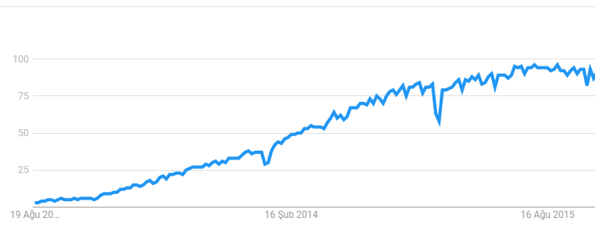
What’s AngularJs?
Notes:
2012-2015 Google trends

Slide 7
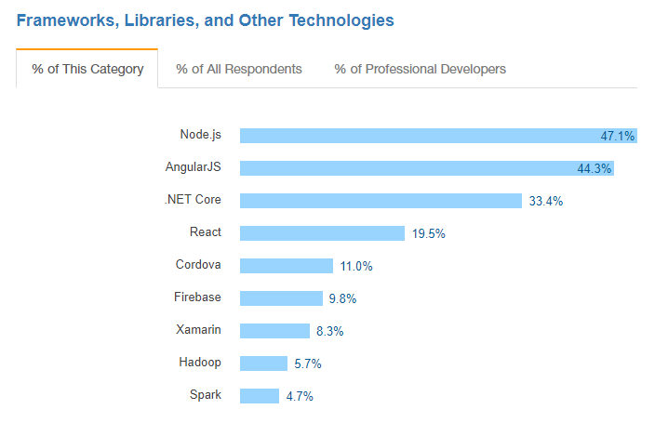
What’s AngularJs?
Notes:
Stackoverflow 2017 survey results

Slide 8































What’s AngularJs?
Yatrum

Slide 9
Agenda
What's AngularJs?
AngularJs vs Angular
Migration from AngularJs to Angular
TypeScript
RxJs
Tooling
Demo

Slide 10
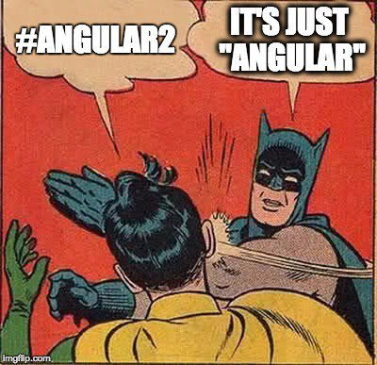



AngularJs vs Angular
AngularJs -> v1.x
angularjs.org
Angular -> v2+
angular.io

Slide 11
AngularJs vs Angular
Patch: 4.0.1
– Just fixes
Minor: 4.1.0
– New Features, Automated updates
Major: 5.0.0
– New Features, Simple updates

Slide 12
AngularJs vs Angular
 | Sep 2015 | May 2016 | Sep 2016 | April 2017
AngularJS | 1.2M | 1.3M | 1.3M | 1.3M
Angular | 85K | 450K | 645K | 810K

Slide 13
Agenda
What's AngularJs?
AngularJs vs Angular
Migration from AngularJs to Angular
TypeScript
RxJs
Tooling
Demo

Slide 14

Migration from AngularJs to Angular
Style guide
TypeScript & build tools
AngularJs 1.5+
Component’ify
ES6’ify
Dual Boot
Services to Angular
Components to Angular
Routing to Angular
Remove AngularJs

Slide 15
Agenda
What's AngularJs?
AngularJs vs Angular
Migration from AngularJs to Angular
TypeScript
RxJs
Tooling
Demo

Slide 16

TypeScript

Slide 17
TypeScript
TypeScript is a Superset of JavaScript
TypeScript
ES2016
Some ES2016/ES7 features
(it’s not out yet)
ES2015
ES5

Slide 18

TypeScript
TypeScript
file.ts
JavaScript
file.js
TypeScript Compiler
Output ES3/ES5/ES2015 compliant code

Slide 19
TypeScript
tsconfig.json
tsconfig.json
{
"compilerOptions": {
"target": "es5",
"module": "system",
"moduleResolution": "node",
"sourceMap": true,
"emitDecoratorMetadata": true,
"experimentalDecorators": true,
"removeComments": false,
"noImplicitAny": true,
"suppressImplicitAnyIndexErrors": true,
"allowJs": true
}
}
Target to Transpile to
ES2016 / ES7 Features

Slide 20
TypeScript
www.typescriptlang.org/play/

Slide 21
Agenda
What's AngularJs?
AngularJs vs Angular
Migration from AngularJs to Angular
TypeScript
RxJs
Tooling
Demo

Slide 22

RxJs

Slide 23
RxJs
Subject
subscribe
unsubscribe
notify
Observer

Slide 24
RxJs
Unlike promises, provides an array of data
Lazy
Async
Chainable
Cancelable

Slide 25
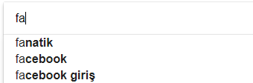

RxJs
Race Condition

Slide 26
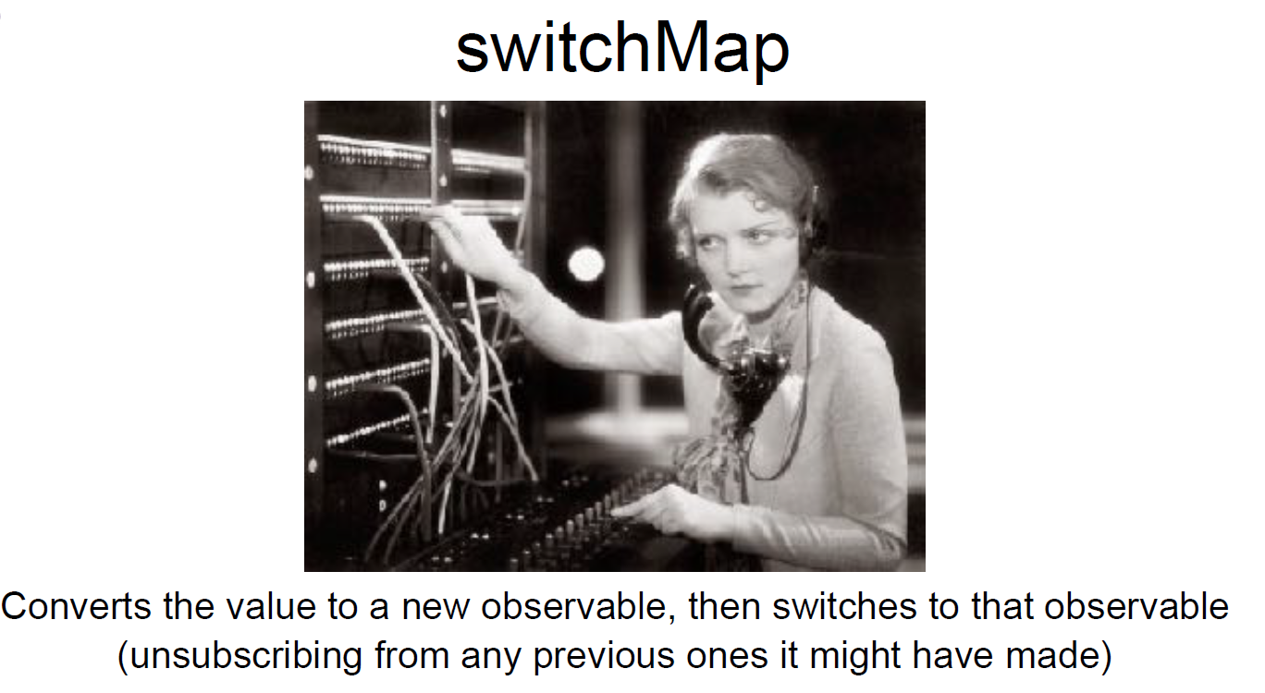
RxJs

Slide 27
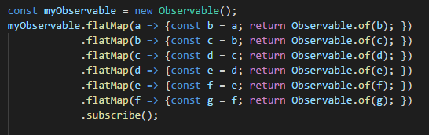
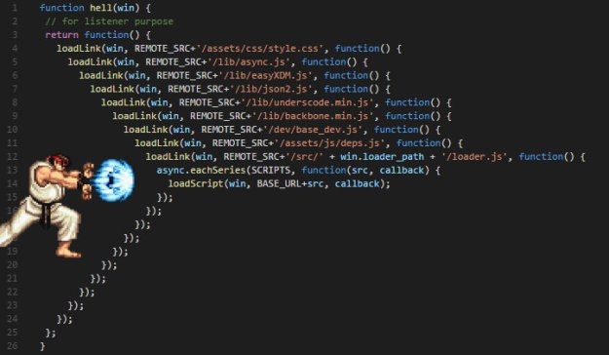
RxJs
Callback Hell

Slide 28
Agenda
What's AngularJs?
AngularJs vs Angular
Migration from AngularJs to Angular
TypeScript
RxJs
Tooling
Demo

Slide 29



Tooling
Angular-cli
VsCode + snippets
Language Service

Slide 30
Agenda
What's AngularJs?
AngularJs vs Angular
Migration from AngularJs to Angular
TypeScript
RxJs
Tooling
Demo

Slide 31


Slide 32

https://github.com/bnymncoskuner/gdg-angular-talk

